Slide 1
AWS Lambda Workshop
Matt Nappo

Slide 2
Agenda
AWS Overview
Traditional vs Serverless Paradigm
AWS Lambda Overview
Example Use Cases
Demo
Workshop
Please feel free to ask questions at any time!

Slide 3
AWS Overview

Slide 4
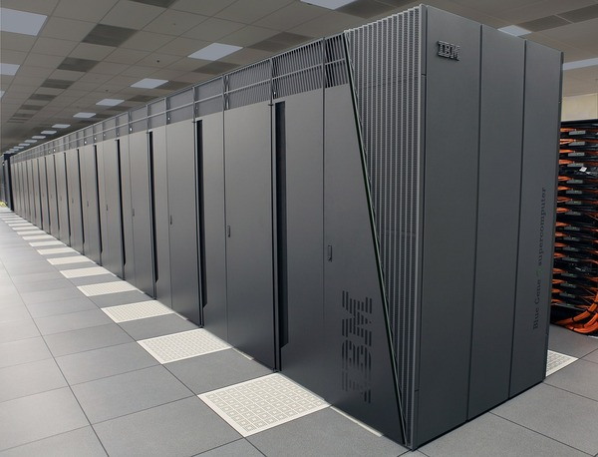
Pre Cloud Computing
Say you’re a startup
Running a web app
Backend services, database, auth servers, frontend
You need to find and buy your own servers
Very expensive
You need to manage that hardware yourself
Requires much expertise
Hard to scale: If you grow, you need to set up even more infrastructure
Potentially around the globe
Potentially not maximizing server usage

Slide 5
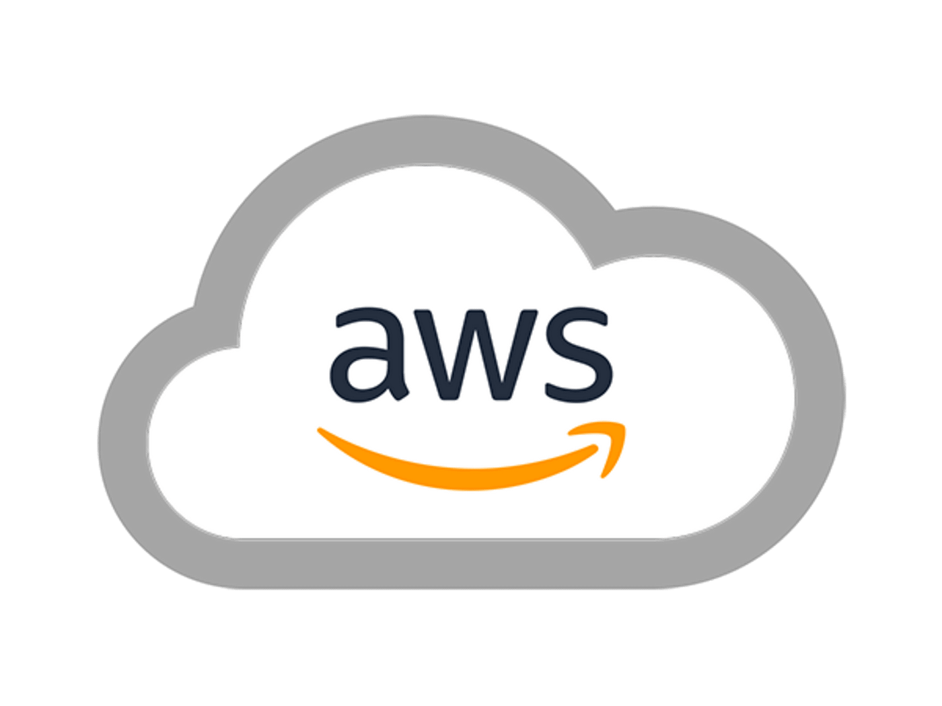
What is Amazon Web Services (AWS)?
Cloud Computing Platform
Customers can “rent” servers
Many products for
SageMaker: AI training and deployment
RDS: Database hosting
SES: Email and notification systems
S3: Object Storage
Virtual clouds, advanced networking, DNS, blockchain apps, etc…
Everything is very interoperable
Main idea: Only pay for what you use

Slide 6
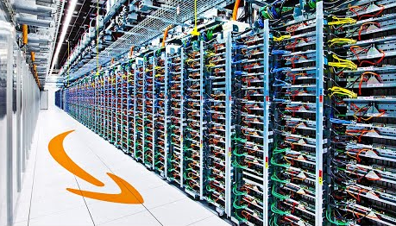
What is Amazon Web Services (AWS)?
~41% market share in cloud computing
Used by
Netflix: $19 million / month
Twitch: $15 million / month
LinkedIn: $13 million / month
Facebook: $11 million / month
High chance you’ve interacted with
AWS in the last week

Slide 7
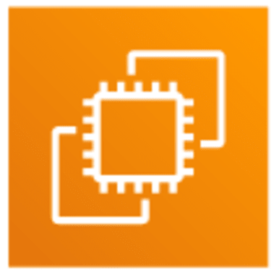
AWS Elastic Compute Cloud (EC2)
EC2 instances are just regular servers that you can run whatever you want on
Most basic and most commonly used AWS product
They come in many sizes
You choose the operating system
Pay per hour
t2.small: 1 CPU core, 2 GB RAM: $0.023 / hour
t4g.medium: 2 CPU cores, 4 GB RAM: $0.0336 / hour
x2iedn.32xlarge: 128 cores 4 TB RAM: $26.676 / hour

Slide 8


AWS Simple Storage Service (S3)
Used for storing arbitrary files
Typically, files are written / uploaded once, and then read many times
Objects (files) live in “Buckets”
Very cheap storage (pay per object)
$0.005 per 1000 requests
$0.023 per GB stored

Slide 9
Traditional vs Serverless

Slide 10
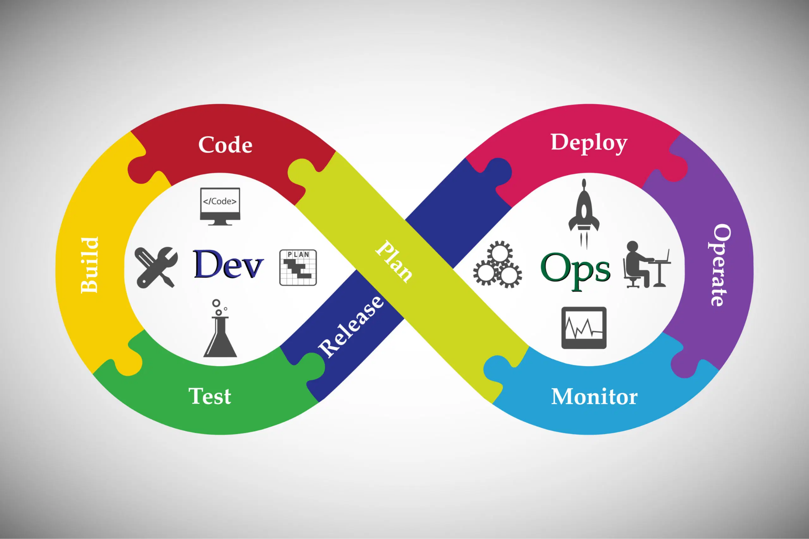
Traditional Paradigm
We want to deploy some code
Have to get a server
Have to choose the right hardware
Have to pick OS, install stuff, setup the firewall
Have to keep the system up to date (security)
Cons:
Unused hardware goes to waste
Surge of requests → server crashes

Slide 11
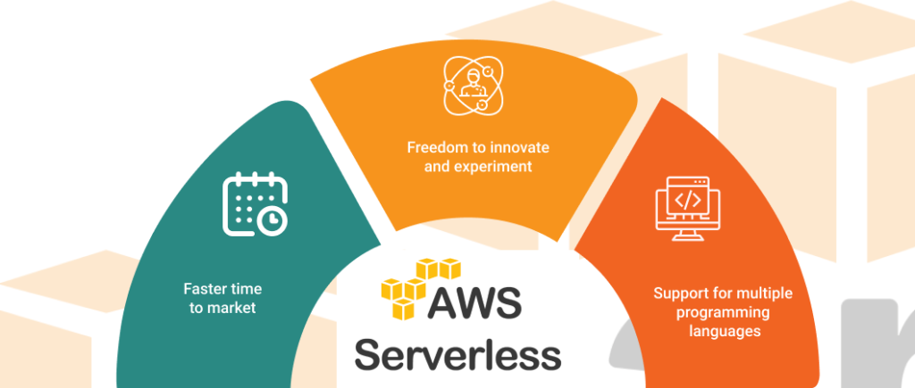
Serverless Paradigm
Abstracting Servers
In the Serverless Paradigm, we abstract away the complexities of managing servers
Servers are still there but hidden from developers
Allows for devs to focus more on writing code, and not on deployment

Slide 12
AWS Lambda

Slide 13
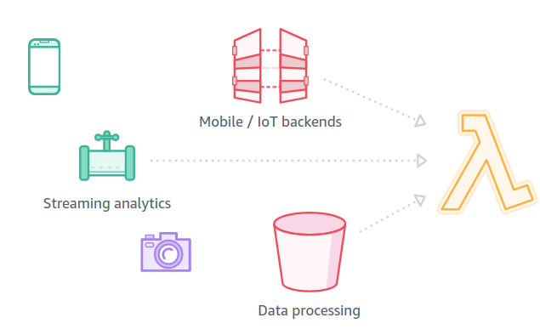
AWS Lambda: A Serverless Product
Developers do two things:
Write their code
Describe how their code will be called
AWS Lambda handles the rest:
Listens for function invocation requests
Automatically executes function calls and returns output
Automatically provisions servers according to demand
Lambda Console

Slide 14

AWS Lambda: Invoking Functions
Many ways to invoke a Lambda function manually:
HTTP endpoint
Lambda API
AWS SDK/CLI
But Lambdas can also be “triggered” when certain events happen:
Changes to an S3 bucket
API Gateway requests
Reads / writes on a database
Scheduled events
The developer has a lot of control when configuring event
triggers

Slide 15

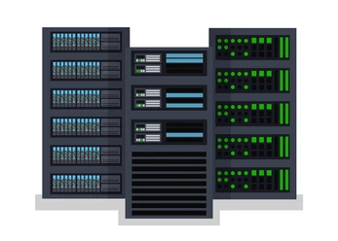
AWS Lambda: Benefits
No need to worry about hardware, CPUs, operating systems, system maintenance, etc
Automatically scales number of workers
Scale to zero
Cheaper, as you only pay for each function invocation
EC2 nano: $0.0042/hr (512MiB)
Lambda: $0.0000000083/ms (512MiB)
1 mil free requests/month
Stateless

Slide 16
Example Use Cases

Slide 17
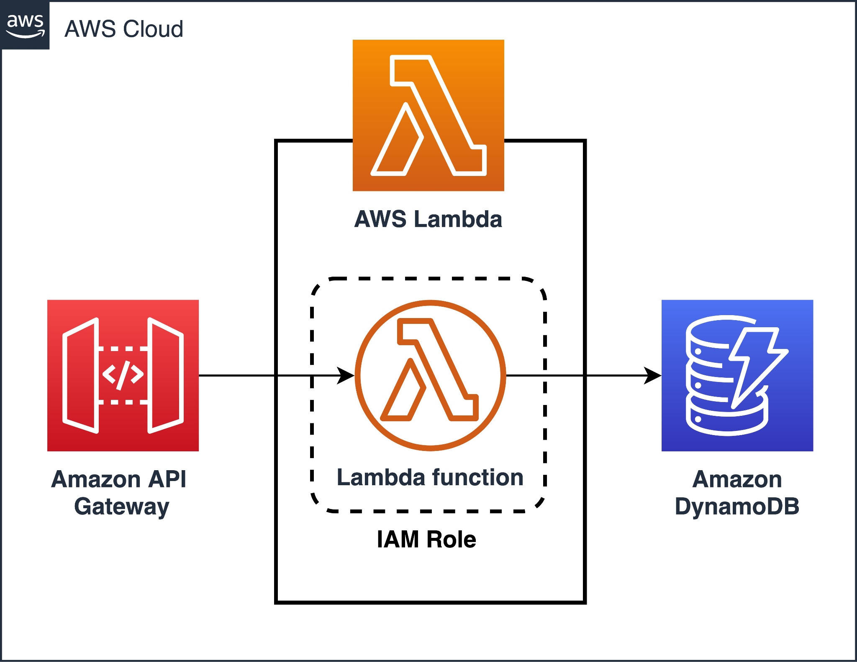
Example Apps
Scalable AI deployment
Token / password generator
Memo / notes app
Image processing apps
File conversion app
Notification systems
Discord bot

Slide 18
Example Apps
Easy and scalable AI deployment
HuggingFace pretrained models
Token / password generator
Image processing apps: captioning, watermarking, filtering
Notification system
File conversion app
Converts
Event trigger: Whenever a certain file type is uploaded to S3
Memo App
Records a
Can view a pdf of all memos
Event trigger: Whenever a text file is uploaded to S3

Slide 19
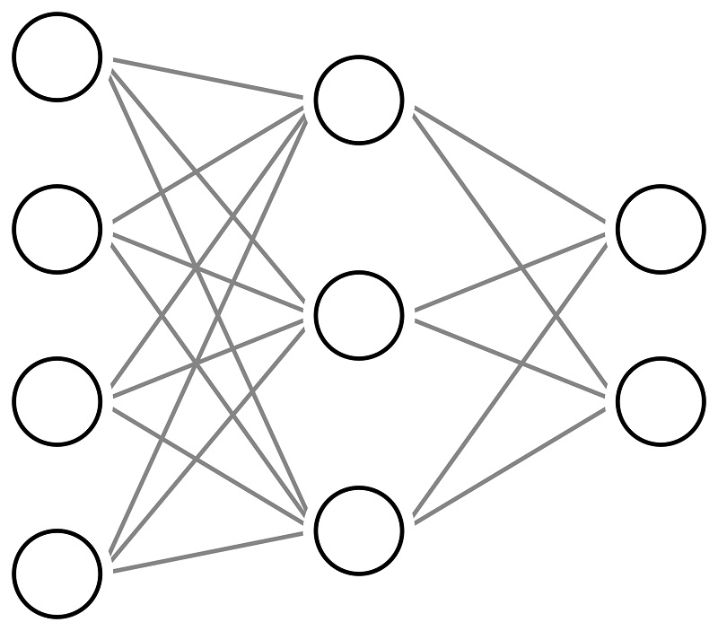
Example: AI Deployment
Idea:
You’re an AI startup that has many AI models
You want users to be able to use them
How to build:
Write functions that take in user input, run the AI, and return output
Possible Event trigger:
If vision AI: S3 image upload
If text-based AI: API request

Slide 20
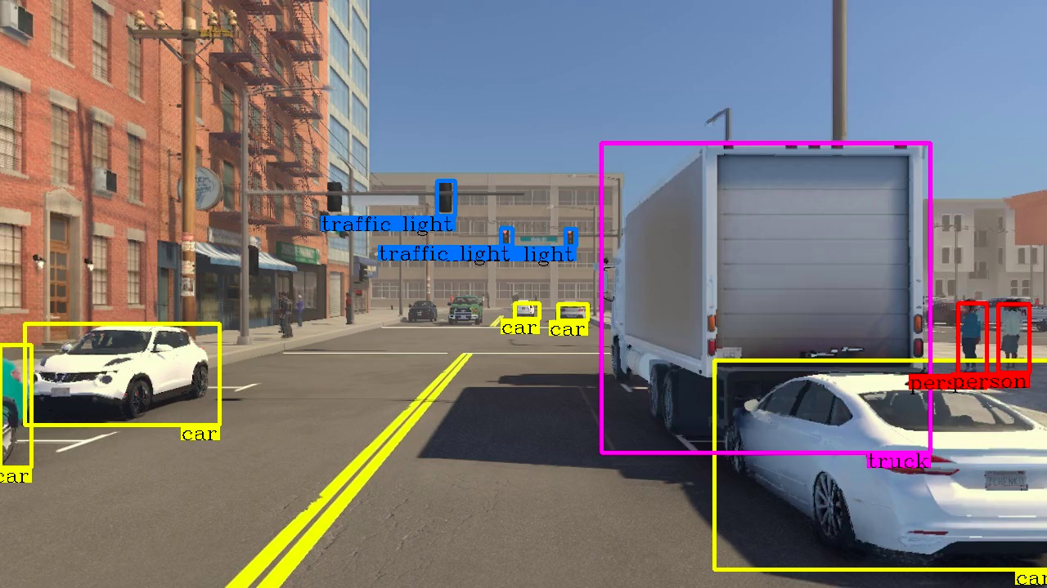
AI Deployment: Object Detection
Say we have an object detection model
Looks at an image, returns positions of objects in the image
Write a function that takes input image and runs our model on it
Upon image upload to S3 bucket:
Automatically run the model on the image
Return or store output

Slide 21

Example: Token Generator
Imagine we’re building a system that provisions resources
Building a large scale API: need to generate user API keys
Building Steam: generate game keys
Building password manager: generate passwords
We write our token generation function(s)
We specify the event triggers:
Create token upon purchase: Database write trigger
If we want a regular REST API: use API Gateway trigger

Slide 22


Example: Memo App
App idea:
Want an app where users can write memos / notes at any time
Users can also generate a PDF file of all their past memos, nicely formatted
How to build:
We write a function to generate a PDF given a bunch of text files from S3
Function is triggered by a text file upload to an S3 bucket

Slide 23
Let’s get started!

Slide 24
Workshop
Make an AWS account
Create a lambda function
Run in test environment
Create API Gateway
Create request model
Run lambda as a real API
Full code:
github.com/mattnappo/lambda-demo

Slide 25
Sources
https://www.skyhighsecurity.com/about/newsroom/blogs.html#:~:text=In%20terms%20of%20revenue,%20Amazon,reported%20revenues%20of%20%249%20billion.
https://www.contino.io/insights/whos-using-aws

